Slide 1


Project 2
Spotify:
Predicting Popularity
Presented by Harsh and Luz

Slide 2


Spotify Data at a Glance
Valency
Energy
Loudness
Year
Explicit
Mode
Acousticness
ID
Name
Instrumentalness
Artist
Release Date
Danceability
Key
Speechiness
Duration_ms
Liveness
Tempo

Slide 3
*Variables and Their Descriptions
valence: happy song-1.0, sad song-0.0
year: Year released
acousticness: a confidence measure. acoustic-1.0, low acoustic-0.0
artists: Artists featured in song
danceability: 1.0-most dancable, 0.0-least danceble
duration_ms: duration of song in milisecond
energy: measure of activity and intensity. 1.0-energetic, 0.0-low energy
explicit: binary 1-explicit, 0-not explicit
id: unique spotify id of the song
instrumentalness: 1.0-has no vocals, 0.0-only vocals (>0.5?)
key: Musical note key, no key is (-1)
liveness: Is the track live or recorded in studio.
loudness: how loud it is in decibels.
mode: major mode or minor mode
name: name of track
popularity: calculated, based on play times
release_date: release date, duh
speechiness: words/speech in track
tempo: beats per minutes or pace of music

Slide 4
Background
Spotify data describes the array of songs the users have available to listen to
These songs are described in variables that can help predict popularity
Popularity is based on the total number of plays and how recent those plays are
In total the data frame has 170653 rows and 18 variables

Slide 5

*Topic
01
What factors cause a track to be more popular than others?
02
Prediction model for popularity based on custom values of variables.
03
Song recommendation model to recommend top 10 similar songs.

Slide 6
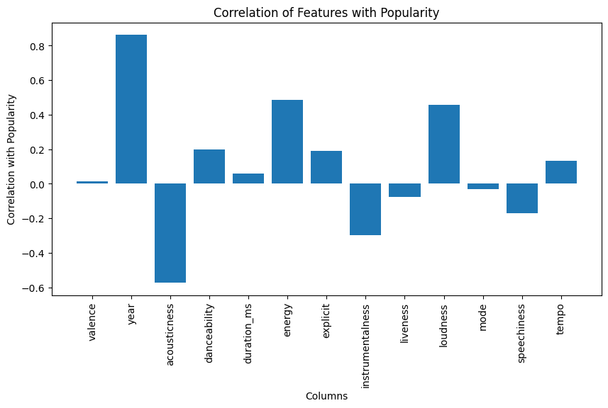
*Correlation with popularity

Slide 7
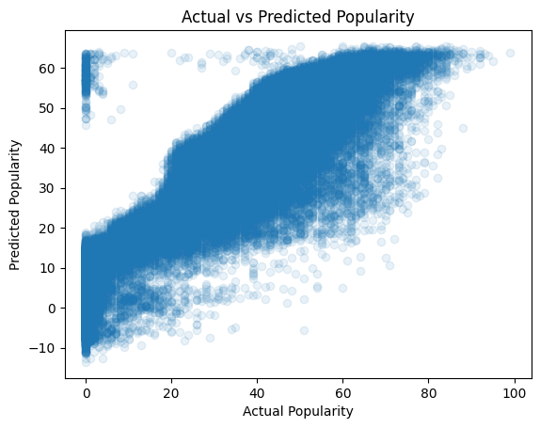
*Prediction model with all the untransformed variables

Slide 8
NOTE that:
Popularity ranks from 0 to 100
We split our data into 3 bins to better predict the top ranking tracks
The low pop bin spans from 0 to 40
Has 105564 rows
The mid pop bin spans from 40 to 80
Has 64540 rows
The high pop bin spans from 80 to 100
Has 549 rows
There are only 39 songs with a popularity >90

Slide 9
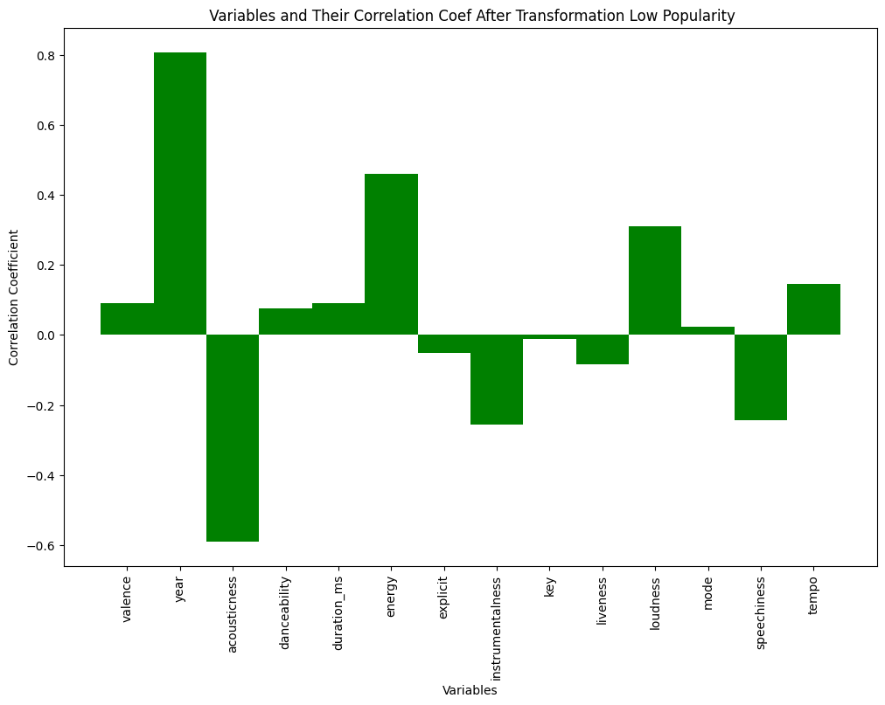
Correlation with popularity After Transformation and Splitting Low Bin
Dropped for LR model:
Key:
Before transformation 0.002
After transformation -0.01
Mode
No transformation 0.024

Slide 10
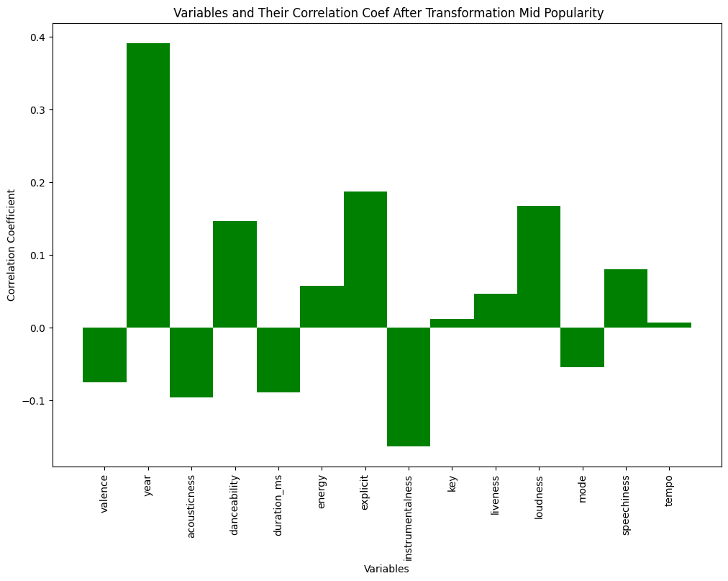
Correlation with popularity After Transformation and Splitting Mid Bin
Dropped for LR Model:
Key
Before Transformation:-0.004
After Transformation :0.011
Tempo
0.007

Slide 11
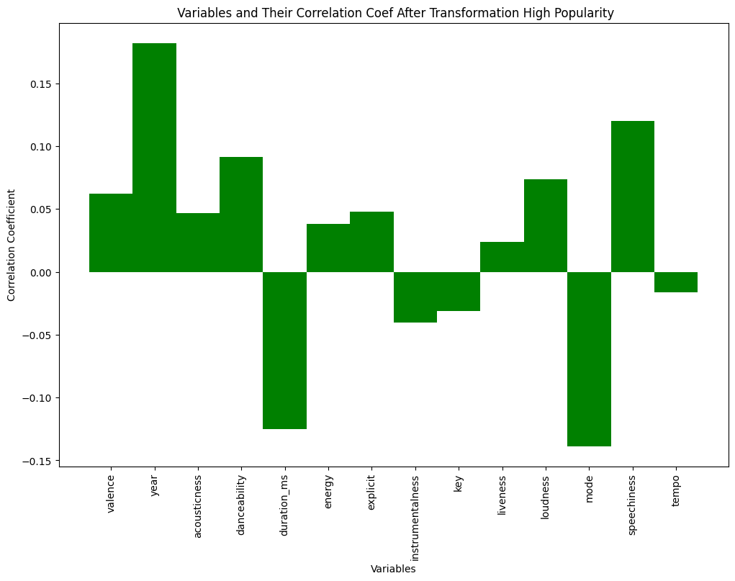
Correlation with popularity After Transformation and Splitting High Bin
No drops for LR Model

Slide 12


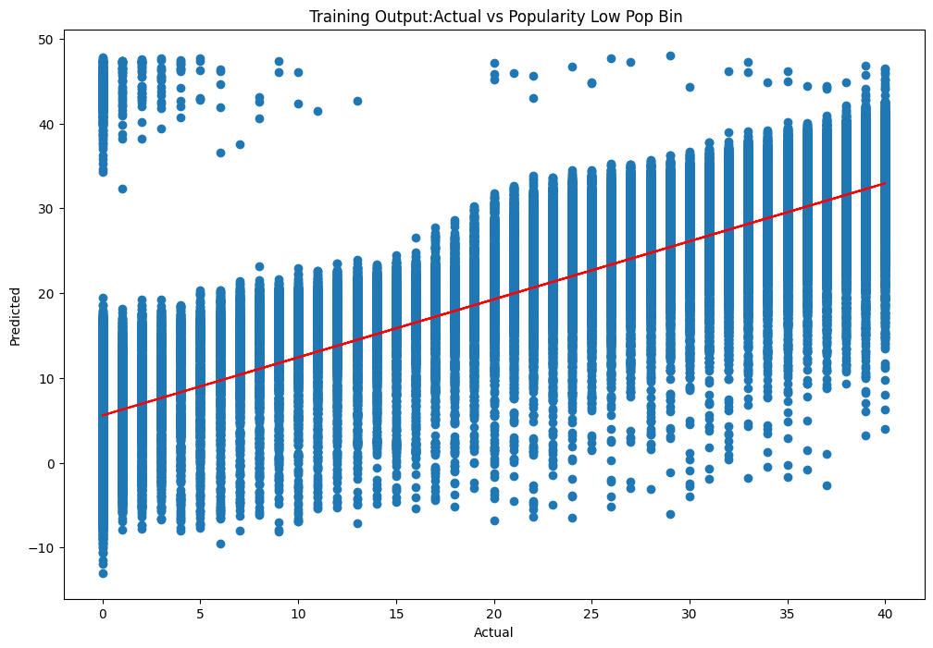
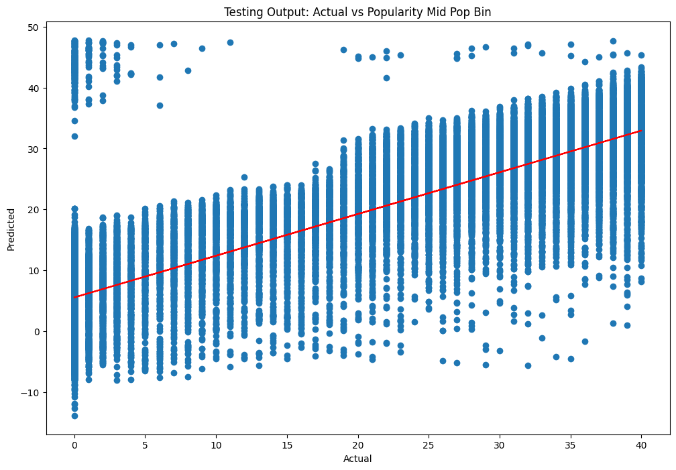
Linear Regression for Low Popularity Tracks
Training
Testing

Slide 13


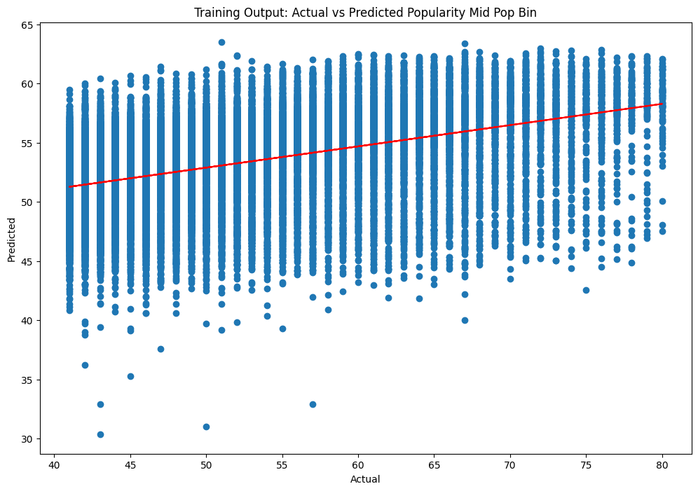
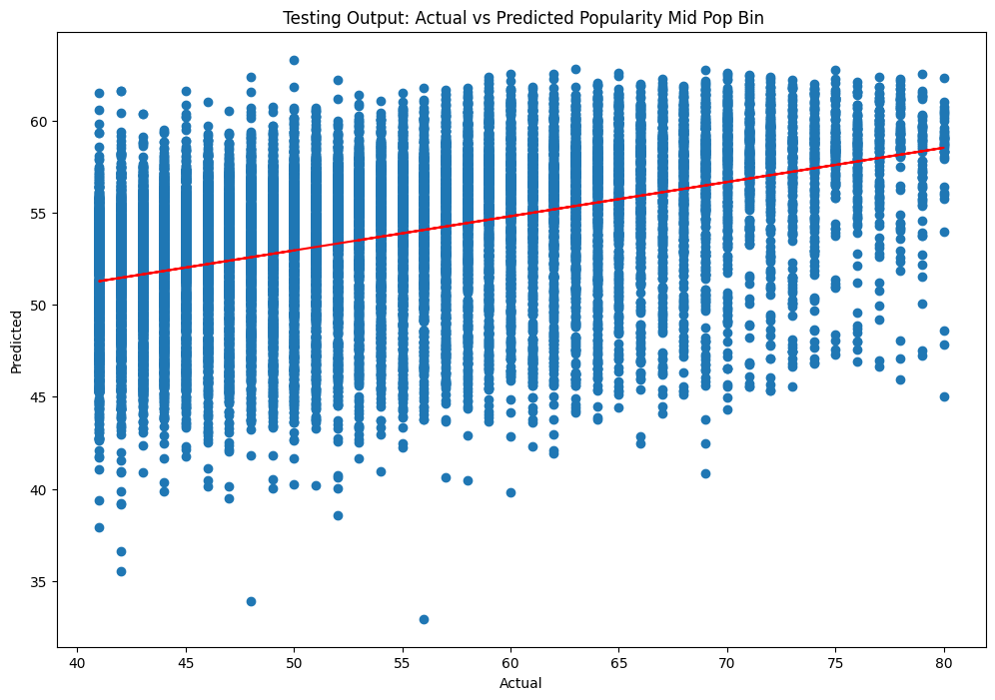
Linear Regression for Mid Popularity Tracks
Training
Testing

Slide 14


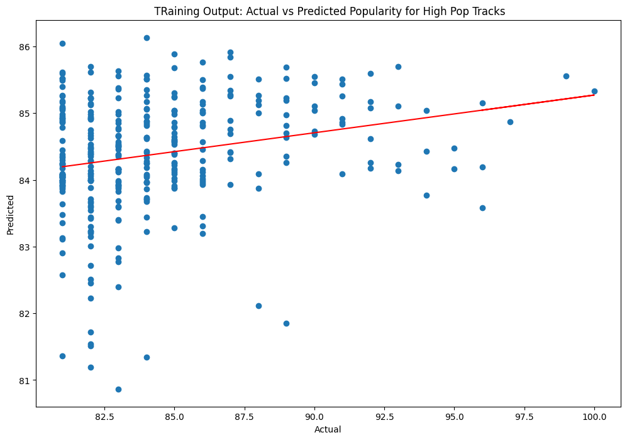
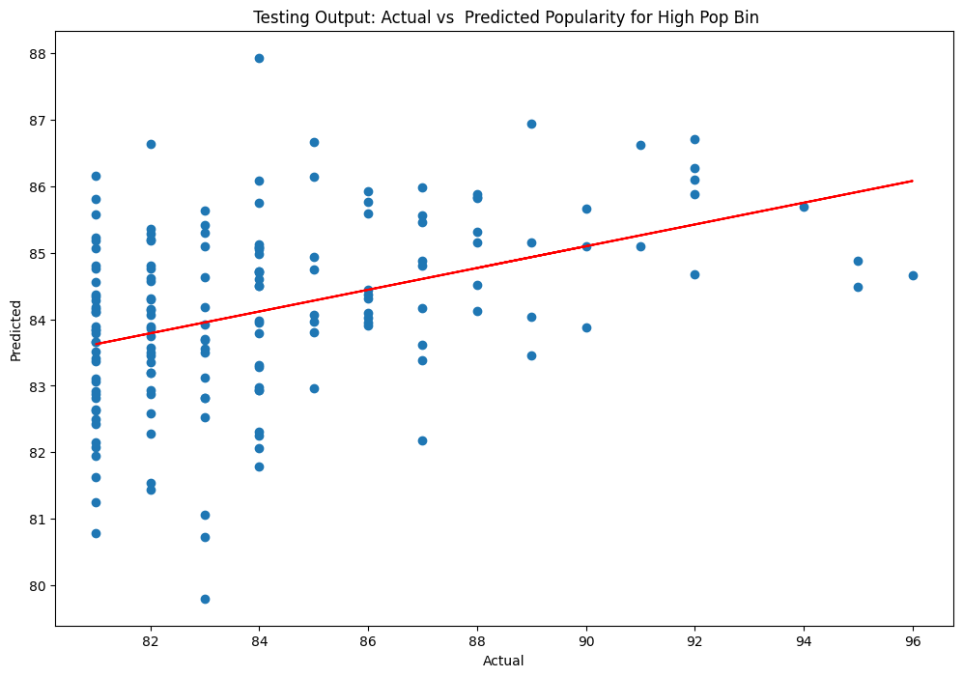
Linear Regression for High Popularity Tracks
Training
Testing

Slide 15
What Variables Will Most Often Predict Popularity ?
We found that Artists, name, ID and Release Date wouldn’t be as useful to predict popularity
For low Pop bin: the most influential variables were all the previous mentioned variables except Key and Mode
For Mid Pop bin: the most influential variables were all except Key and tempo
All variables were included in determining high popular songs

Slide 16
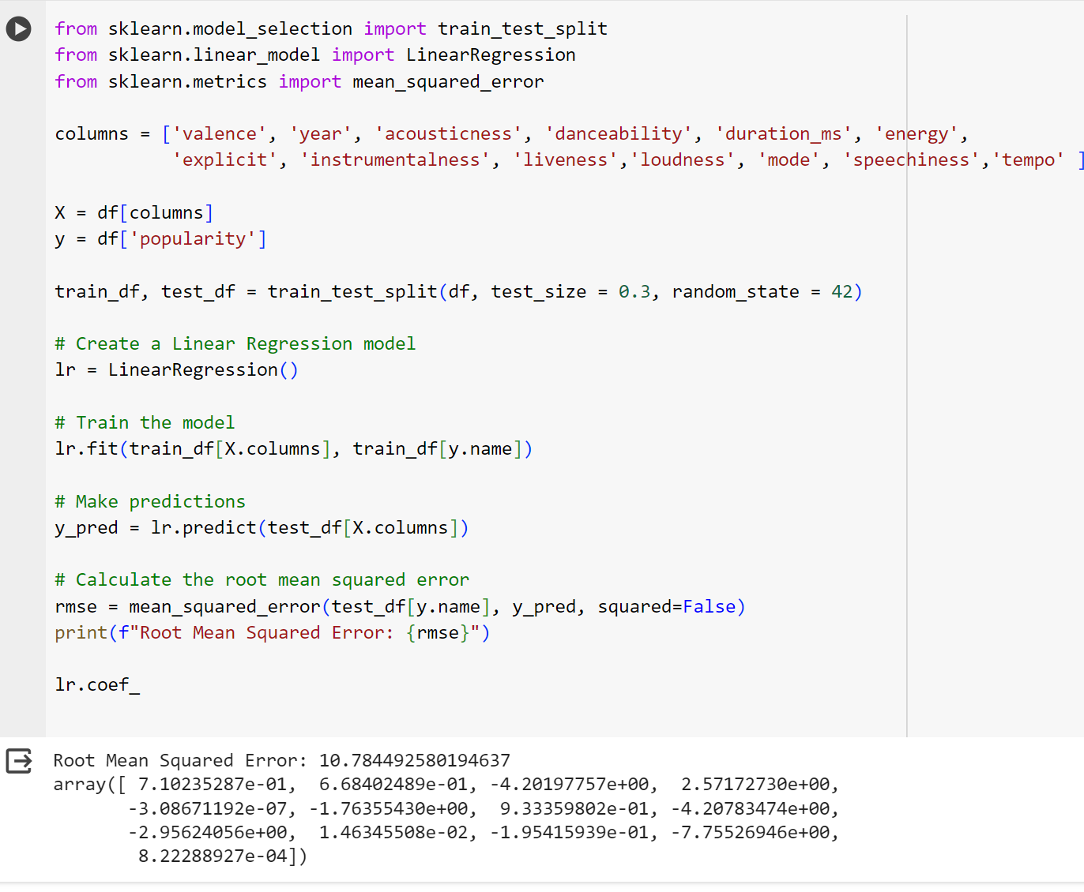

*Linear Regression Model

Slide 17
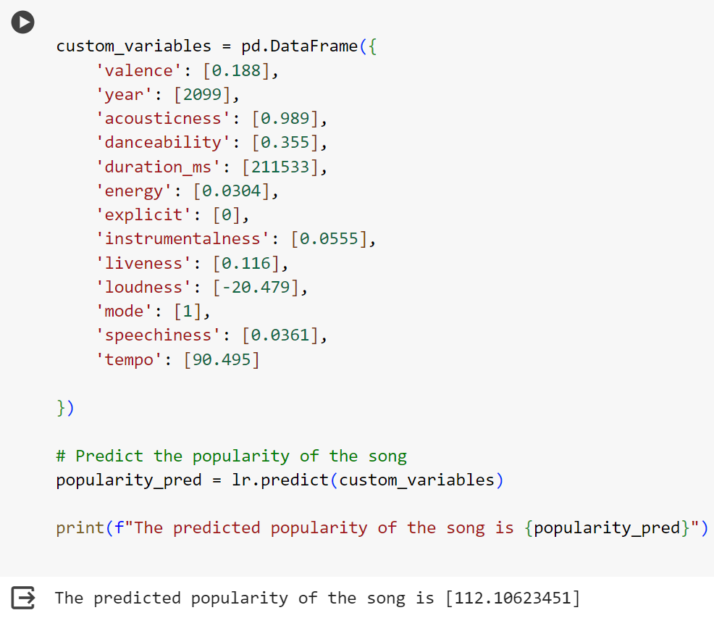
*Predicting the popularity
Name: My favourite song
'valence': [0.188],
'year': [2099],
'acousticness': [0.989],
'danceability': [0.355],
'duration_ms': [211533],
'energy': [0.0304],
'explicit': [0],
'instrumentalness': [0.0555],
'liveness': [0.116],
'loudness': [-20.479],
'mode': [1],
'speechiness': [0.0361],
'tempo': [90.495]
Predicted popularity: 112.10

Slide 18
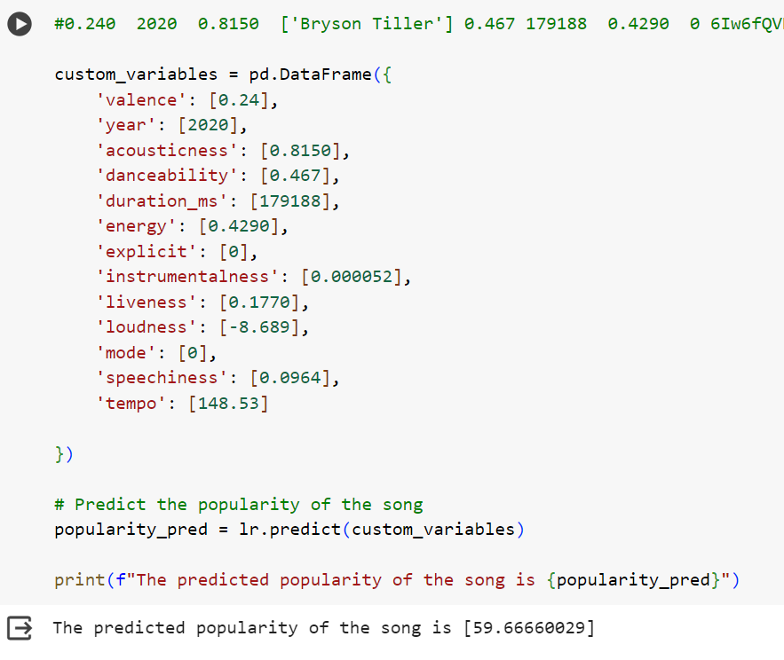
*Predicting the popularity

Slide 19
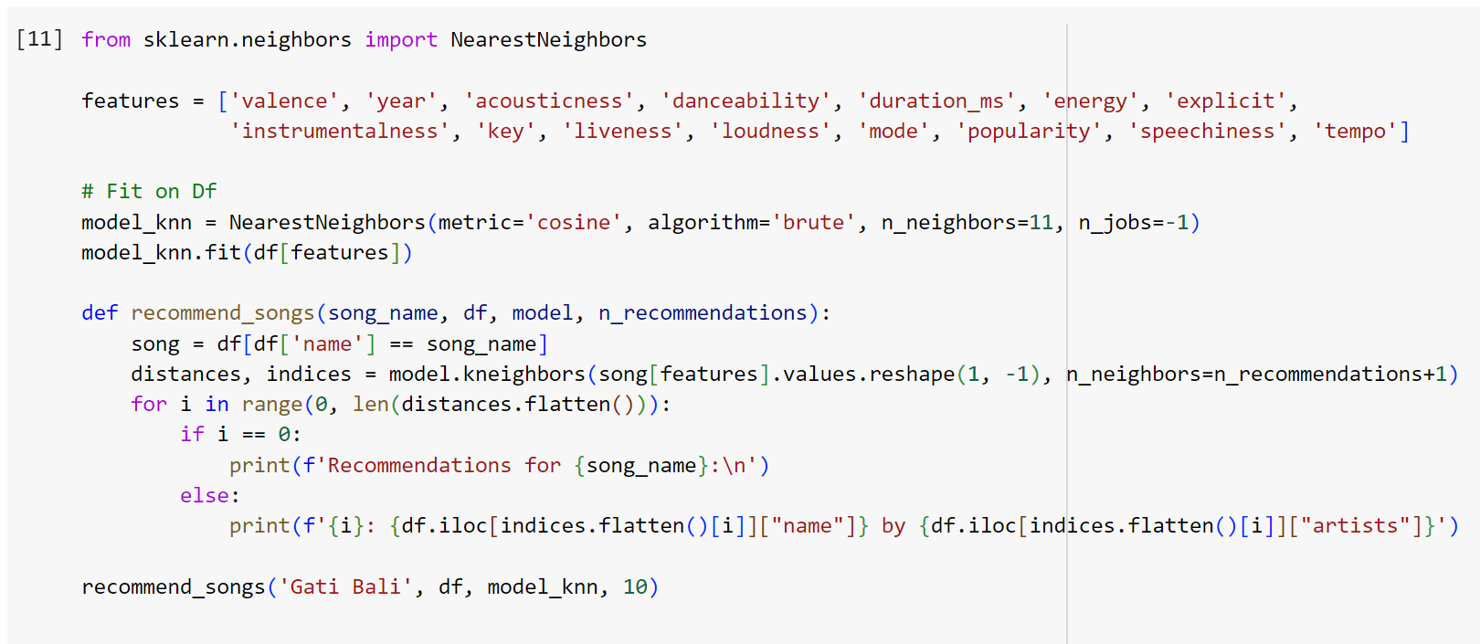
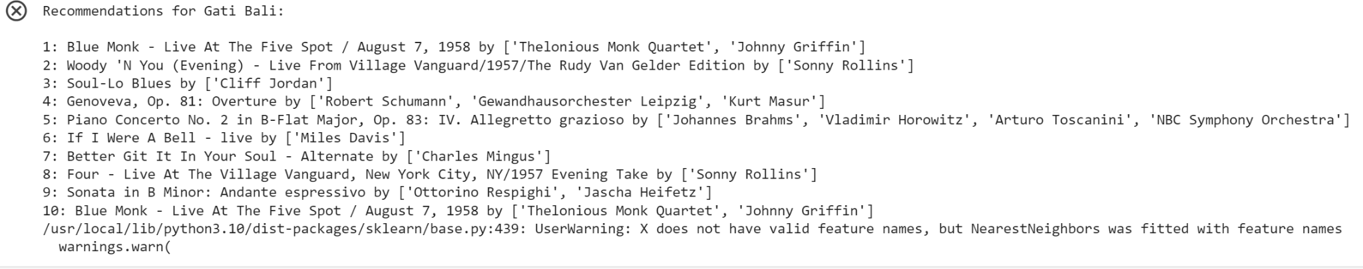
* Recommendation model for Songs

Slide 20
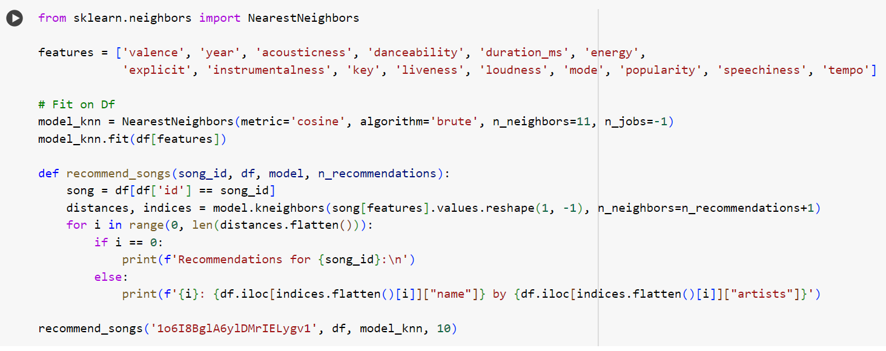
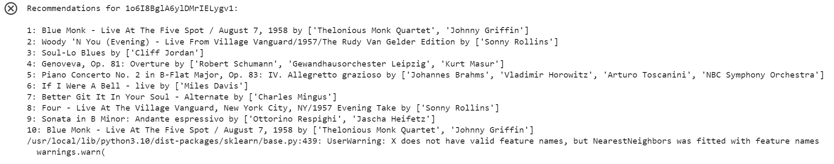
*Recommendation model for Songs

Slide 21
*Recommendation model for Songs
We used nearest neighbour principle to recommend 10 nearest neighbour
metric='cosine': sets the distance metric for the k-NN model to cosine similarity.
algorithm='brute': This sets the algorithm used to compute the nearest neighbors to ‘brute’, which uses a brute-force search.
n_neighbors=11: This sets the number of neighbors to use by default for k-NN queries to 11.
Notes:
Cosine similarity is a measure of similarity between two non-zero vectors of an inner product space that measures the cosine of the angle between them.

Slide 22
Conclusion
Variables can help us predict the popularity of a songs through linear regression models. Because the data is not uniform, breaking into bins helps ensure prediction where the data is scarce
Songs can be recommended to other users by using a nearest neighbor model according to their likes

Slide 23

Thank You Questions?

